Slide 1
Ancylostoma duodenale
Common Name: The Old World hookworm.
DR SOWMYA R.S.G
DEPT OF PATHOLOGY AND MICROBIOLOGY
SKHMC

Slide 2
Geographical Distribution.
It is found in Europe, North Africa (specially prevalent in Egypt), India (Punjab and Uttar Pradesh), Sri Lanka, Central and North China, Pacific Islands and Southern States of America.

Slide 3
Habitat.
The adult worm lives in the small intestine of man, particularly in the jejunum, less often in the duodenum and rarely in the ileum.

Slide 4
Morphology.
ADULT WORM:
It is small, greyish white, cylindrical worm.
When freshly passed, the worm has a reddish brown colour due to the ingested blood in its intestinal tract.
The anterior end of the worm is bent slightly dorsally, hence the name hookworm.

Slide 5
This bend is in the same direction as the general body curvature.
The large & conspicuous buccal capsule is lined with a hard substance & is provided with 6 teeth 4 hook like on the ventral surface & 2 knob like ( triangular plates ) on the dorsal surface.
There are five glands connected with the digestive system; one of them, called the oesophageal gland, secretes a ferment which prevents the clotting of blood.

Slide 6
The sexes are easily differentiated by their sizes, the shape of the tail (posterior end) and the position of the genital opening – assumes a Y – shaped figure during copulation.

Slide 7
Copulatory bursa. - This consists of 3 lobes
1 Dorsal & 2 Lateral. Each lobe is supported by Chitinous rays; The dorsal lobe contains 3 rays ( 1 single & 2 externodorsal rays). 2 Lateral lobes contain 10 rays ( 3 pairs of lateral rays and 2 pairs of ventral rays). Total number of rays are 13.
Life Span – 3 -4 years

Slide 8
EGGS.
The eggs are passed out with the faeces
(i) Oval or elliptical in shape, measuring 65 um in length by 40 um in breadth.
(ii) Colourless (not bile-stained).
(iii) Surrounded by a transparent hyaline shell-membrane.
(iv) Contains a segmented ovum usually with 4 blastomeres; has a clear space between the eggshell and the segmented ovum.

Slide 9
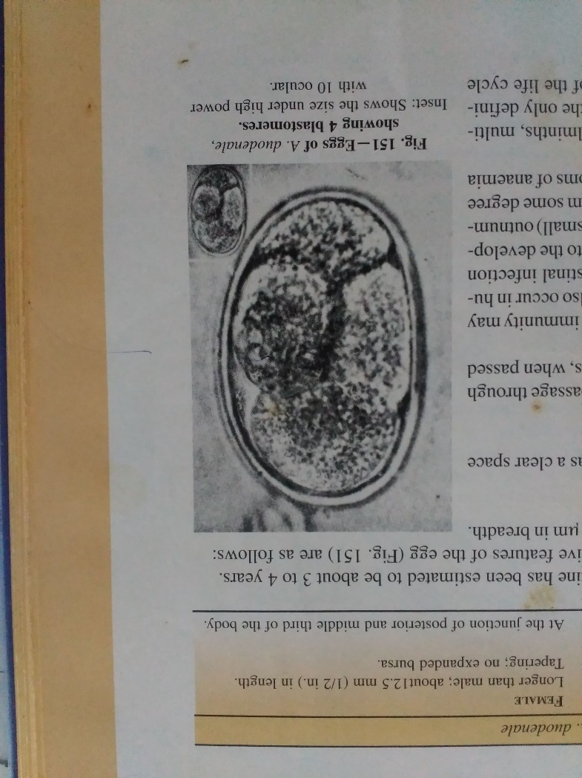

Slide 10
Floats in saturated solution of common salt.
The eggs are first laid in an unsegmented stage and during their passage through the bowel, segmentation proceeds up to the 4-celled stage. The eggs, when passed out with the faeces, are not infective to man.

Slide 11
Immunology.
In endemic areas most patients have minimal intestinal infection and no significant symptoms of anaemia and this may be attributed to the development of a partial immunity.

Slide 12
Life Cycle.
No intermediate host is required and like other helminths, multiplication of worms does not occur inside the human body.
Man is the only definitive host for A. duodenale. The following are the various stages of the life cycle

Slide 13
STAGE 1. - Passage of Eggs from the Infected Host. The eggs, containing segmented ova with 4 blastomeres, are passed out in the faeces of the human host.

Slide 14
STAGE 2. Development in Soil.
From each egg a rhabditiform larva (250 μm in length) hatches out in the soil in about 48 hours. The rhabditiform larva moults twice, on the third day and the fifth day. It then develops into a filariform larva (500 to 600 um in length), the infective stage of the parasite. The time taken for development from eggs to filariform larvae is on an average 8 to 10 days.

Slide 15
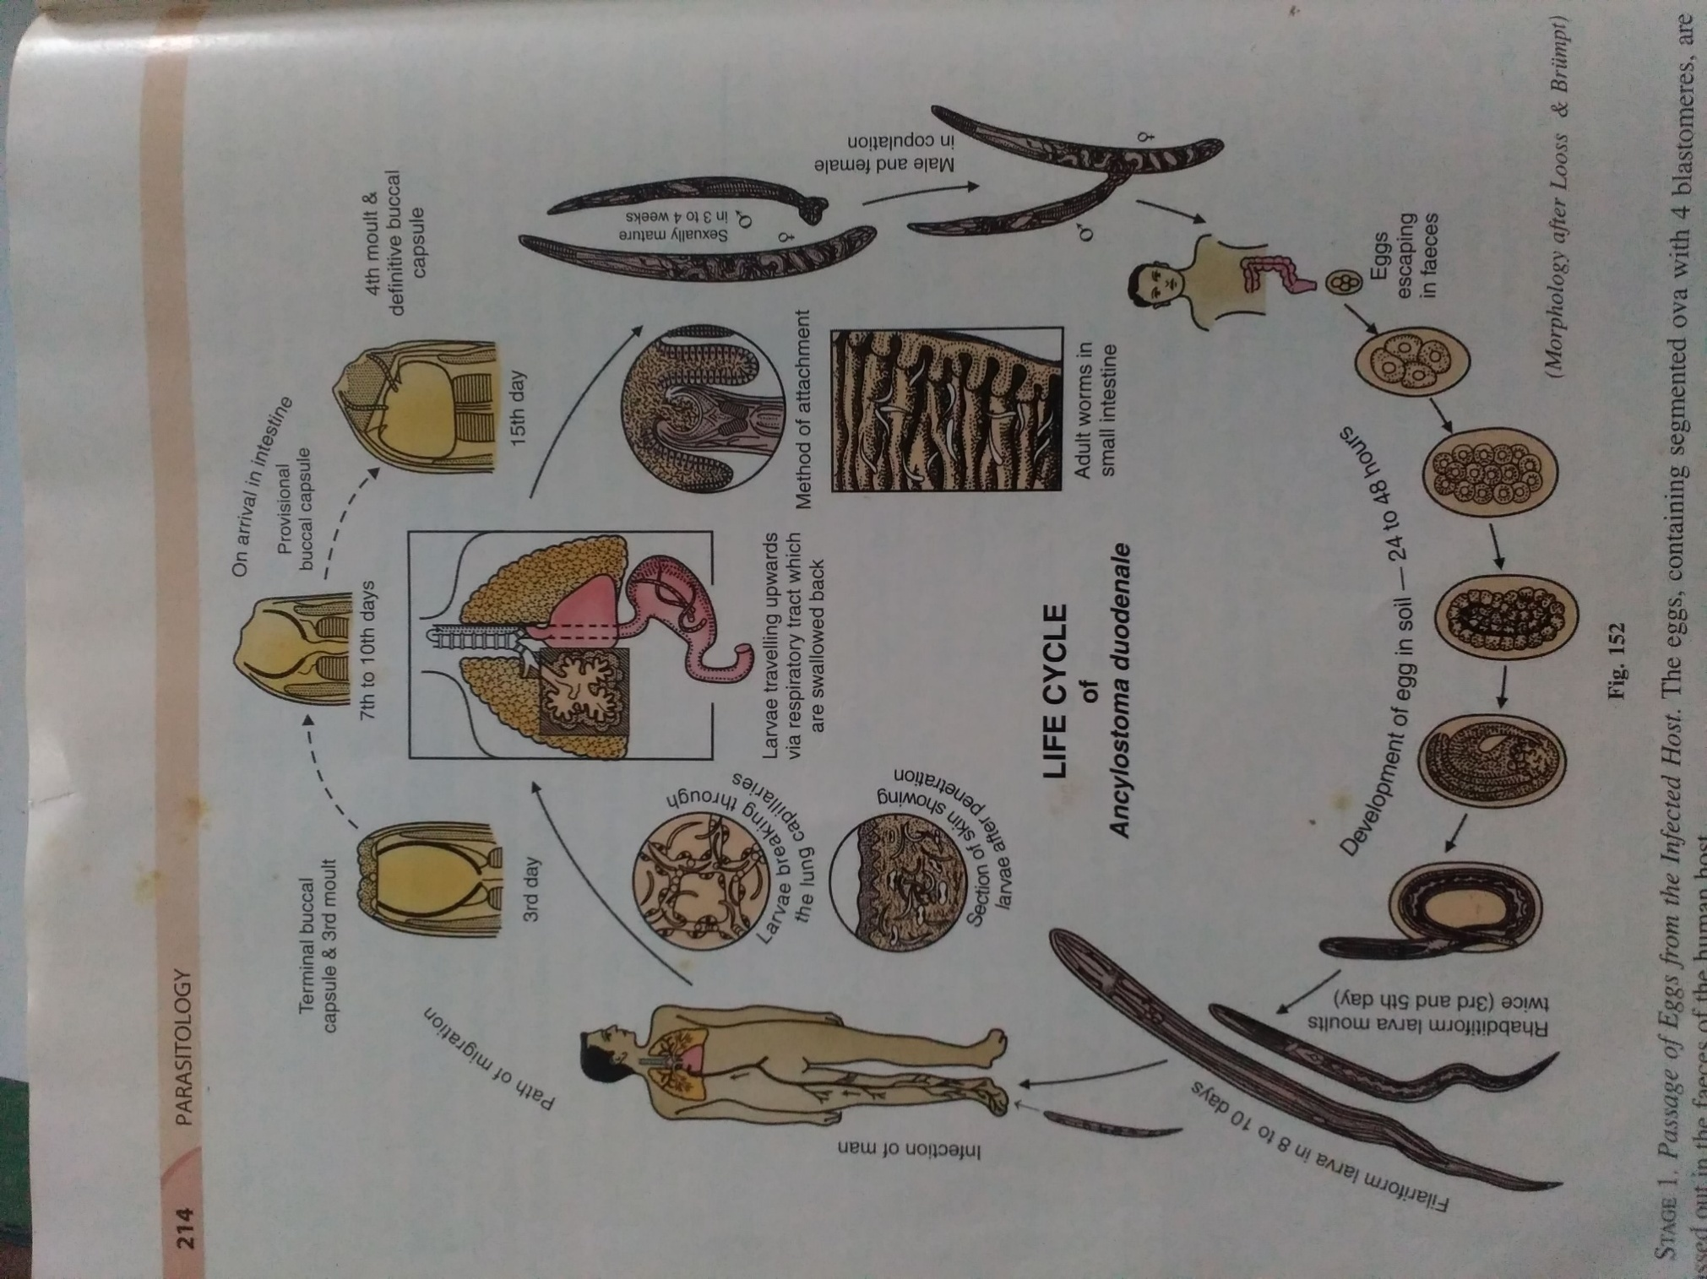

Slide 16
STAGE 3. - Entrance into a New Host.
The filariform larvae are infective to man. The larvae cast off their sheaths and gain entrance to the body by penetrating the skin.

Slide 17
STAGE 4. - Migration.
On reaching the subcutaneous tissues, the larvae enter into the lymphatics or small venules.
They pass through the lymph-vascular system into the venous circulation and are carried via the right heart into the pulmonary capillaries, where they break through the capillary walls and enter into the alveolar spaces.
They then migrate on to the bronchi, trachea and larynx, crawl over the epiglottis to the back of the pharynx and are ultimately swallowed. The period taken for such migration is about 10 days.

Slide 18
STAGE 5. - Localisation and Laying of Eggs
The growing larvae settle down in the small intestine, undergo a fourth moulting and develop into adolescent worms.
At this stage, the provisional toothless buccal capsule, formed previously, is cast off and the definitive buccal capsule complete with teeth, is formed.

Slide 19
In 3 to 4 weeks’ time, they are sexually mature and the fertilised females begin to lay eggs in the faeces. The cycle is thus repeated.
The interval between the time of skin infection and the first appearance of eggs in the faeces, is about 6 weeks.

Slide 20
Pathogenesis
1. PATHOGENIC EFFECTS CAUSED BY ANCYLOSTOME LARVAE
(a) LESIONS IN THE SKIN:
  Ancylostome dermatitis and
  Creeping eruption.
(b) ANCYLOSTOME DERMATITIS OR GROUND ITCH.
Occurs at the site of entry. It is more commonly seen with Necator infection than with Ancylostoma and generally disappears in the course of one to two weeks’ time. The skin lesion precedes the general symptoms of ancylostomiasis by 2 to 4 months.

Slide 21
CREEPING ERUPTION
It is a condition in which the filariforrn larvae wander about through the skin in an aimless manner for several weeks and months (up to 2 years), producing a reddish itchy papule along the path traversed by the larvae (termed “larva migrans”). This is particularly seen with those species of parasites (A. braziliense and A. caninum) which are not adapted to man and therefore after having penetrated the skin layers, cannot proceed to normal development in the small bowel.

Slide 22
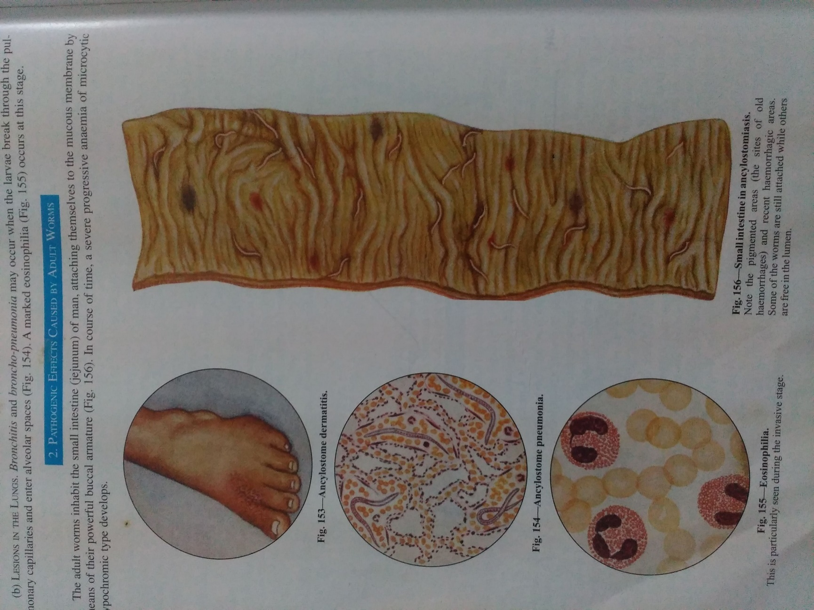

Slide 23
(b) LESIONS IN THE LUNGS.
    Bronchitis and broncho-pneumonia may occur when the larvae break through the pulmonary capillaries and enter alveolar Spaces . A marked eosinophilia occurs at this stage.
2. PATHOGENIC EFFECTS CAUSED BY ADULT WORMS
In course of time, a severe progressive anaemia of microcytic hypochromic type develops.

Slide 24
Causes of Anaemia
CHRONIC BLOOD LOSS
This results from the withdrawal of blood by
parasites for their food
chronic haemorrhages from the punctured sites.

Slide 25
ii) NUTRITIONAL DEFECTS:
It is apparent that a chronic blood loss cannot be fully compensated for infected individuals with a faulty diet. Depending upon the nature of the nutritional defect, the types of anaemia may vary. Iron deficiency, a hypo-chromic microcytic anaemia and
with deficiency of folic acid and vitamin B12 (extrinsic factor of Castle), a macrocytic type of anaemia; deficiency of both iron and vitamin B12 or folic acid causes dimorphic anaemia.

Slide 26
Clinical Features of Hookworm Anaemia.
These may be considered under two heads:
Gastro-intestinal manifestations and Effects of anaemia.
l. Gastrointestinal Manifestations. There may be dyspeptic troubles associated with epigastric tenderness simulating duodenal ulcer.
Occasionally, the patient may have an abnormal appetite showing a perverted taste for such things as earth, mud or lime (pica or geophagy).
Bowels are generally constipated.

Slide 27
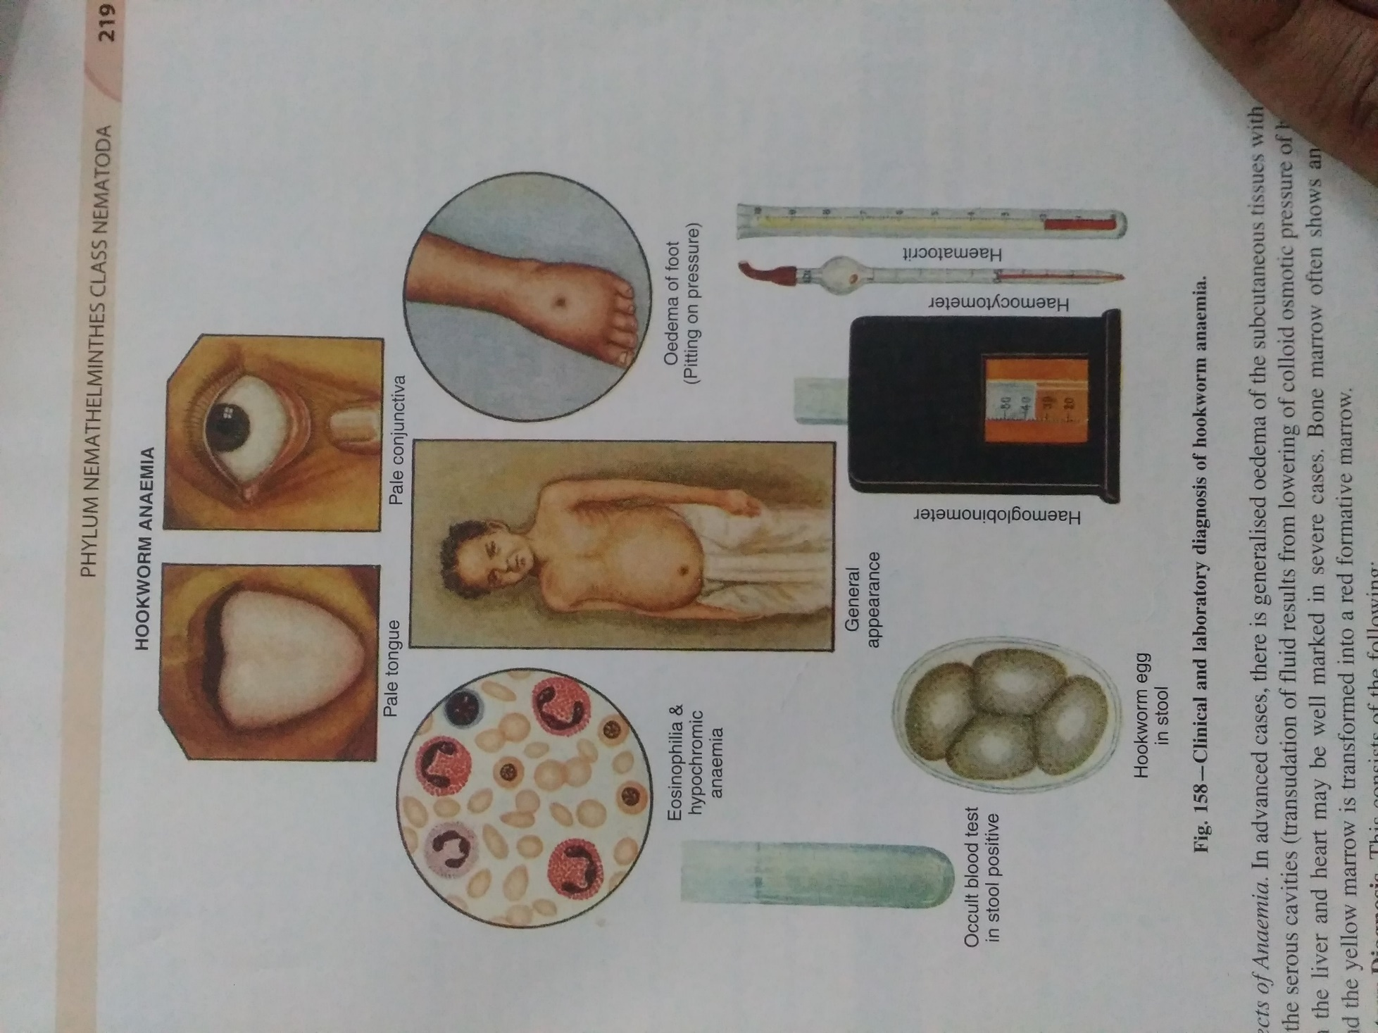

Slide 28
2. Effects of Anaemia.
The skin assumes a sallow appearance (light yellow colour) and the mucous membrane of the eyes, lips and tongue shows extreme pallor.
The face appears puffy with the swelling of lower eyelids and there is oedema of the feet and ankle.
Koilonychia is frequently observed.

Slide 29
The general appearance of the patient is a pale plumpy individual with protuberant abdomen and dry lustreless hair.
The effect of anaemia on cardiovascular system is manifested by a hyperkinetic circulatory state which may ultimately lead to circulatory failure.
Growth and development in children may be retarded.

Slide 30
Blood Changes in Hookworm Infection.
Typical haemograms of distinctive types of anaemia seen in hookworm infection are given in the table below.

Slide 31
Laboratory Diagnosis.
This consists of the following:
1. DIRECT METHODS
(i) Examination of Stool. A macroscopic examination of stool is necessary to find the adult worms which may be passed out spontaneously or after a vermifuge.
A direct microscopical examination of stool may easily demonstrate the presence of characteristic hookworm eggs. Concentration method may be used.

Slide 32
For estimating the intensity of hookworm infection, the various egg-counting methods may be employed.
(ii) Study of Duodenal Contents. The material obtained by duodenal intubation (Ryle’s tube) may sometimes reveal either eggs or the adult worms (Necator or Ancylostoma or both).

Slide 33
2. INDIRECT METHODS
(i) Examination of Blood. This is carried out to ascertain the nature of anaemia and the presence of eosinophilia.
(ii) General Examination of Stool. In a majority of cases of hookworm anaemia, test for occult blood in the stool gives a positive reaction. Charcot-Leyden crystals are often found in the stool.

Slide 34
SPECIFIC DIAGNOSIS.
A specific diagnosis of hookworm anaemia whether due to A. duodenale or N. americanus cannot be made from the morphology of eggs discovered in an examination of the stool. Such a distinction can only be made by studying the morphology of adult worms or the mature infective filariform larvae.

